Slide 1
Lecture 17
User and Kernel Threads
National University of
Computer & Emerging Sciences

Slide 2
Process Characteristics
Concept of Process has two facets.
A Process is:
  A Unit of resource ownership:
    a virtual address space for the process image
    control of some resources (files, I/O devices...)
  A Unit of execution - process is an execution path through one or more programs
    may be interleaved with other processes
    execution state (Ready, Running, Blocked...) and dispatching priority

Slide 3
Process Characteristics
These two characteristics are treated separately by some recent operating systems:
  The unit of resource ownership is usually referred to as a process or task
  The unit of execution is usually referred to a thread or a “lightweight process”

Slide 4
Its better to distinguish between the two concepts
  Address space/Global Variables
  Open files
  Child processes
  Accounting info
  Signal handlers
  Program counter
  Registers
  Stack
  State
Heavy weight process
In case of multiple threads per process
Unit of Resource
Split
Unit of Execution/Dispatch
  Program counter
  Registers
  Stack
  State
Light weight processes
  Address space/Global Variables
  Open files
  Child processes
  Accounting info
  Signal handlers
  Program counter
  Registers
  Stack
  State
  Program counter
  Registers
  Stack
  State
Share

Slide 5

Single and Multithreaded Processes

Slide 6
When to use threads?
If a program can be organized into discrete, independent tasks which can execute concurrently

Slide 7
User Threads vs Kernel Threads
User Thread - management done by user-level threads library
Kernel Threads - supported by the Kernel
    Windows XP/2000, Linux, Mac OS X…

Slide 8
User-Level Threads (ULT) (ex. Java)
Kernel not aware of the existence of threads
Thread management handled by thread library in user space
No mode switch (kernel not involved)
But I/O in one thread could block the entire process!

Slide 9
Threads library
Contains code for:
  creating and destroying threads
  passing messages and data between threads
  scheduling thread execution
    pass control from one thread to another
  saving and restoring thread contexts
ULT’s can be be implemented on any Operating System, because no kernel services are required to support them

Slide 10
Kernel Role for ULTs (None!)
The kernel is not aware of thread activity
  it only manages processes
If a thread makes an I/O call, the whole process is blocked
  Note: in the thread library that thread is still in “running” state, and will resume execution when the I/O is complete
So thread states are independent of process states

Slide 11
Advantages and disadvantages of ULT
Advantages
Thread switching does not involve the kernel: no mode switching
Therefore fast
Scheduling can be application specific: choose the best algorithm for the situation.
Can run on any OS. We only need a thread library
Disadvantages
Most system calls are blocking for processes. So all threads within a process will be implicitly blocked
The kernel can only assign processors to processes. Two threads within the same process cannot run simultaneously on two processors

Slide 12
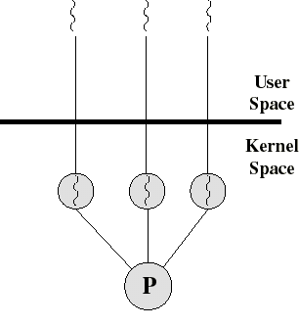
Kernel-Level Threads (KLT)
Ex: Windows NT, Windows 2000, OS/2
All thread management is done by kernel
No thread library; instead an API to the kernel thread facility
Kernel maintains context information for the process and the threads
Switching between threads requires the kernel
Kernel does Scheduling on a thread basis

Slide 13
Advantages and disadvantages of KLT
Advantages
The kernel can schedule multiple threads of the same process on multiple processors
Blocking at thread level, not process level
  If a thread blocks, the CPU can be assigned to another thread in the same process
Even the kernel routines can be multithreaded
Disadvantages
Thread switching always involves the kernel. This means 2 mode switches per thread switch
So it is slower compared to User Level Threads
  (But faster than a full process switch)

Slide 14
Multithreading Models
Many-to-One
One-to-One
Many-to-Many

Slide 15
Many-to-One
Many user-level threads mapped to single kernel thread
Examples:
  Solaris Green Threads
  GNU Portable Threads

Slide 16
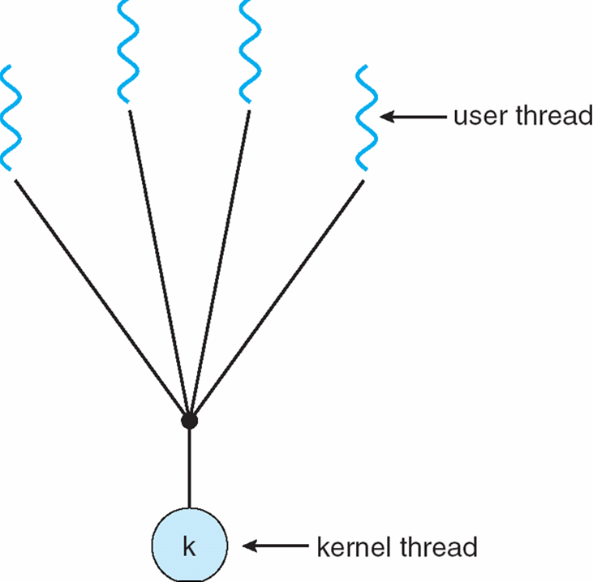
Many-to-One Model

Slide 17
One-to-One
Each user-level thread maps to kernel thread
Examples
  Windows NT/XP/2000
  Linux
  Solaris 9 and later

Slide 18
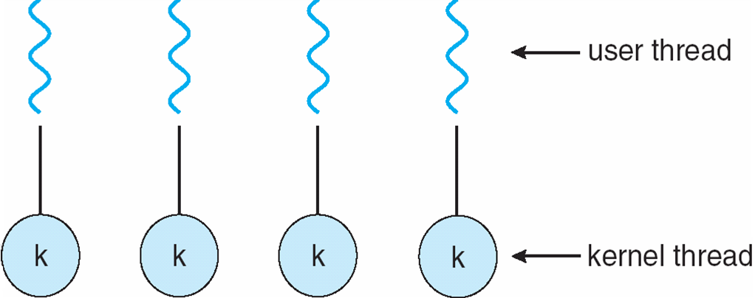
One-to-one Model

Slide 19
Many-to-Many Model
Allows many user level threads to be mapped to many kernel threads
Allows the operating system to create a sufficient number of kernel threads
Solaris prior to version 9
Windows NT/2000 with the ThreadFiber package

Slide 20

Many-to-Many Model

